Slide 1
Computer Vision: Image Augumentation
Eng Teong Cheah

Slide 2
Objective
图像增广基于现有训练数据生成随机图像从而应对过拟合。

Slide 3
Contents
Image Augmentation

Slide 4
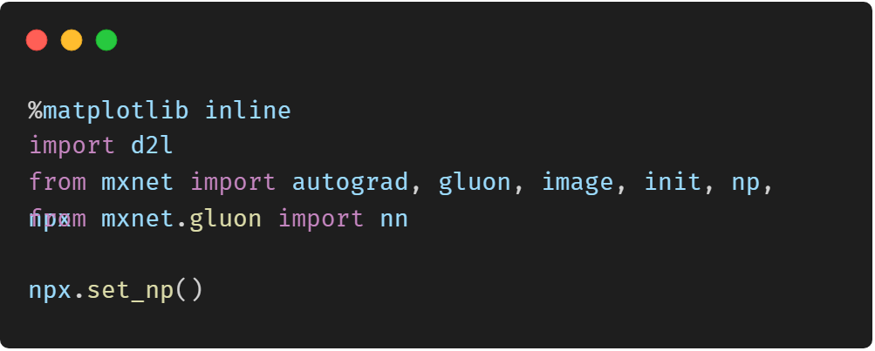
Image Augmentation

Slide 5
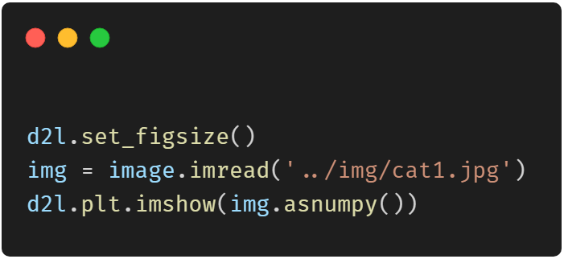
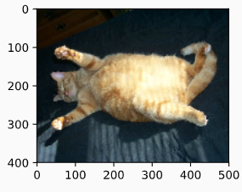
Common Image Augmentation Method

Slide 6
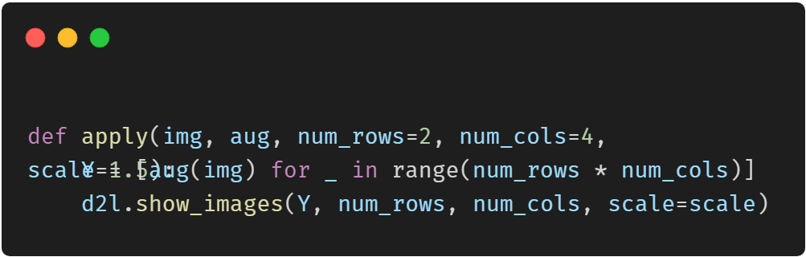
Common Image Augmentation Method

Slide 7
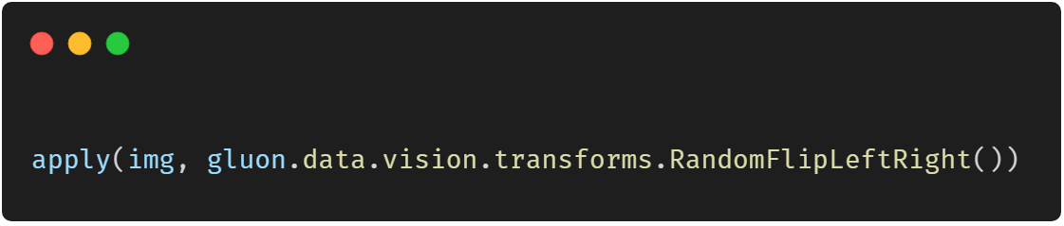
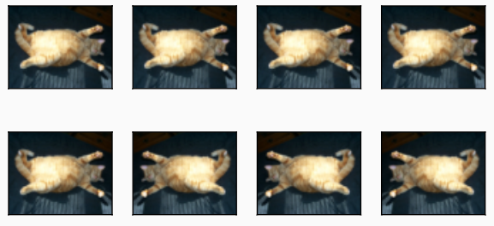
Flip and Crop

Slide 8
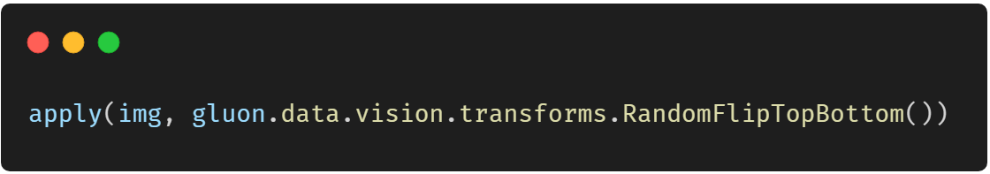
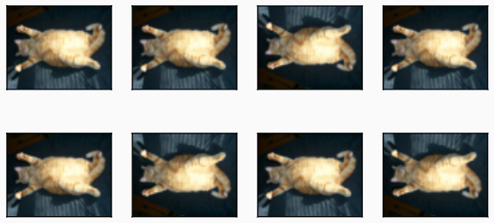
Flip and Crop

Slide 9
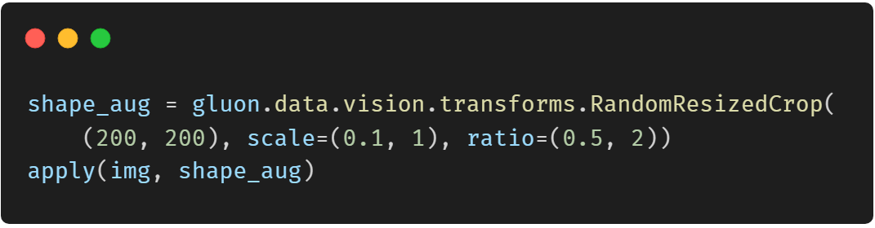
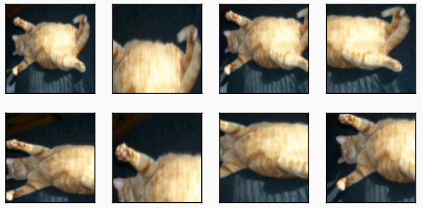
Flip and Crop

Slide 10
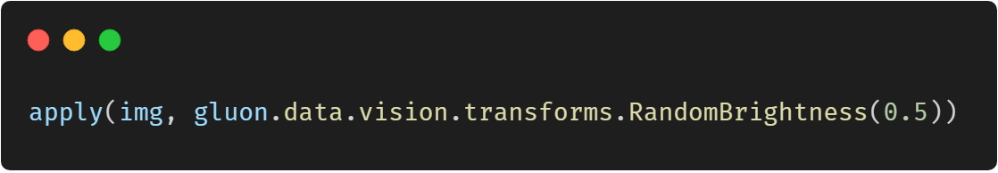
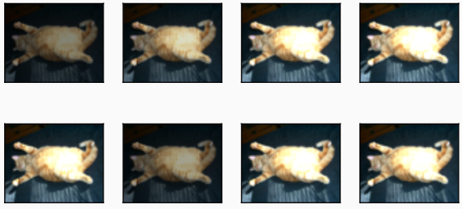
Change Color

Slide 11
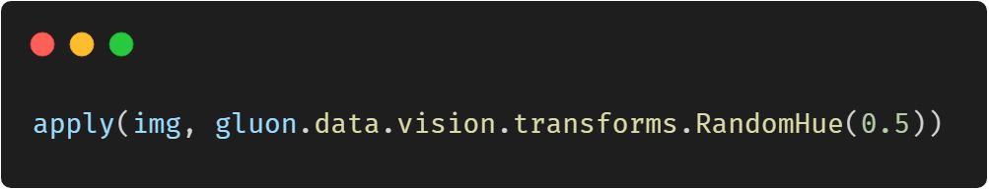
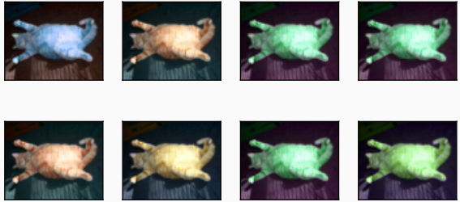
Change Color

Slide 12
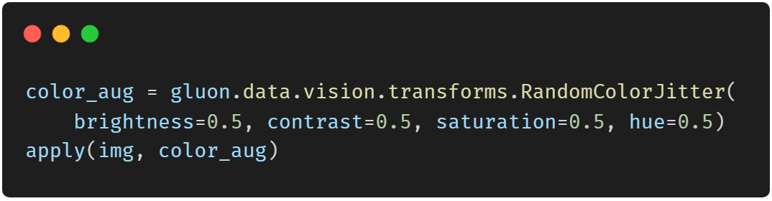
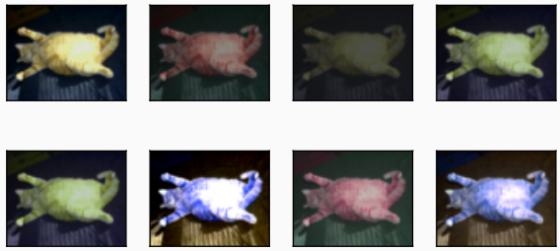
Change Color

Slide 13
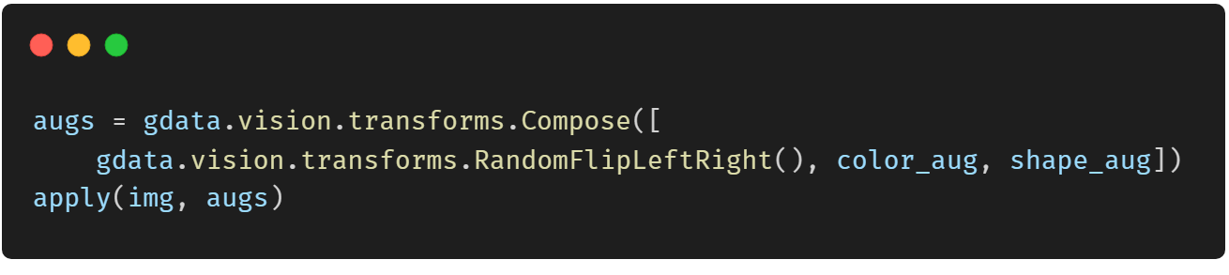
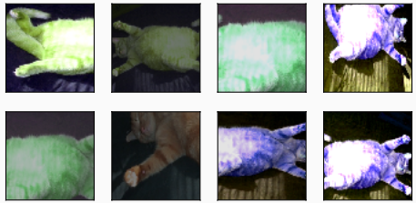
Overlying Multiple Image Augmentation Methods

Slide 14
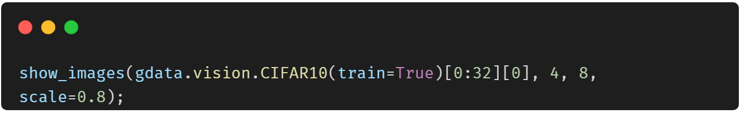
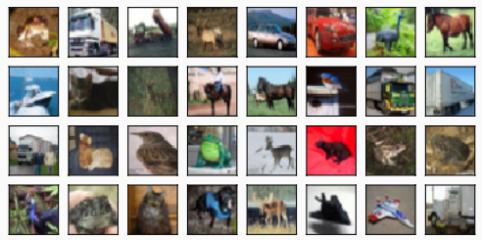
Using an Image Augmentation Training Model

Slide 15
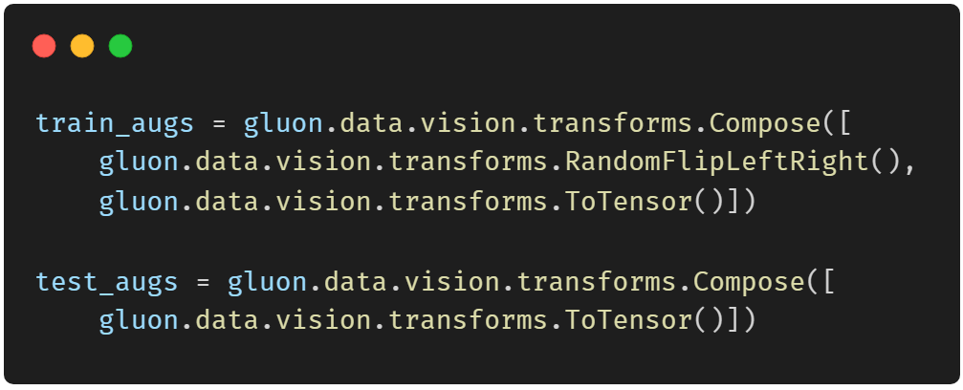
Using an Image Augmentation Training Model

Slide 16
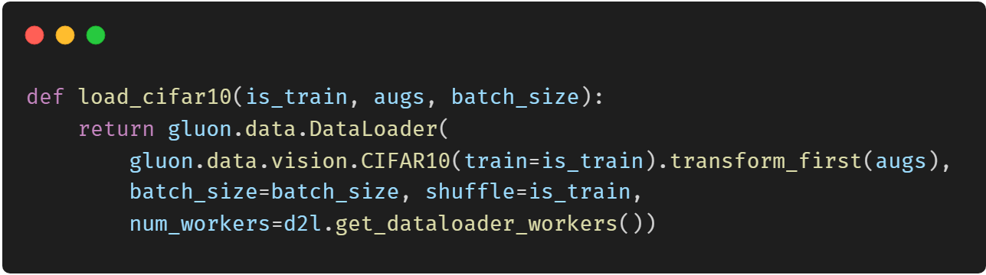
Using an Image Augmentation Training Model

Slide 17
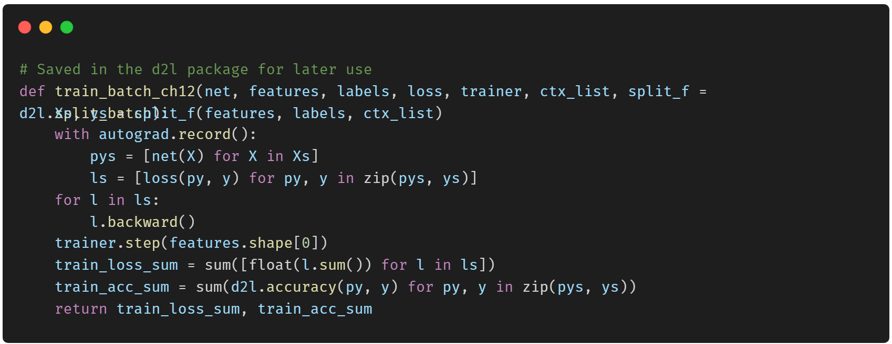
Using a Multi-GPU Training Model

Slide 18
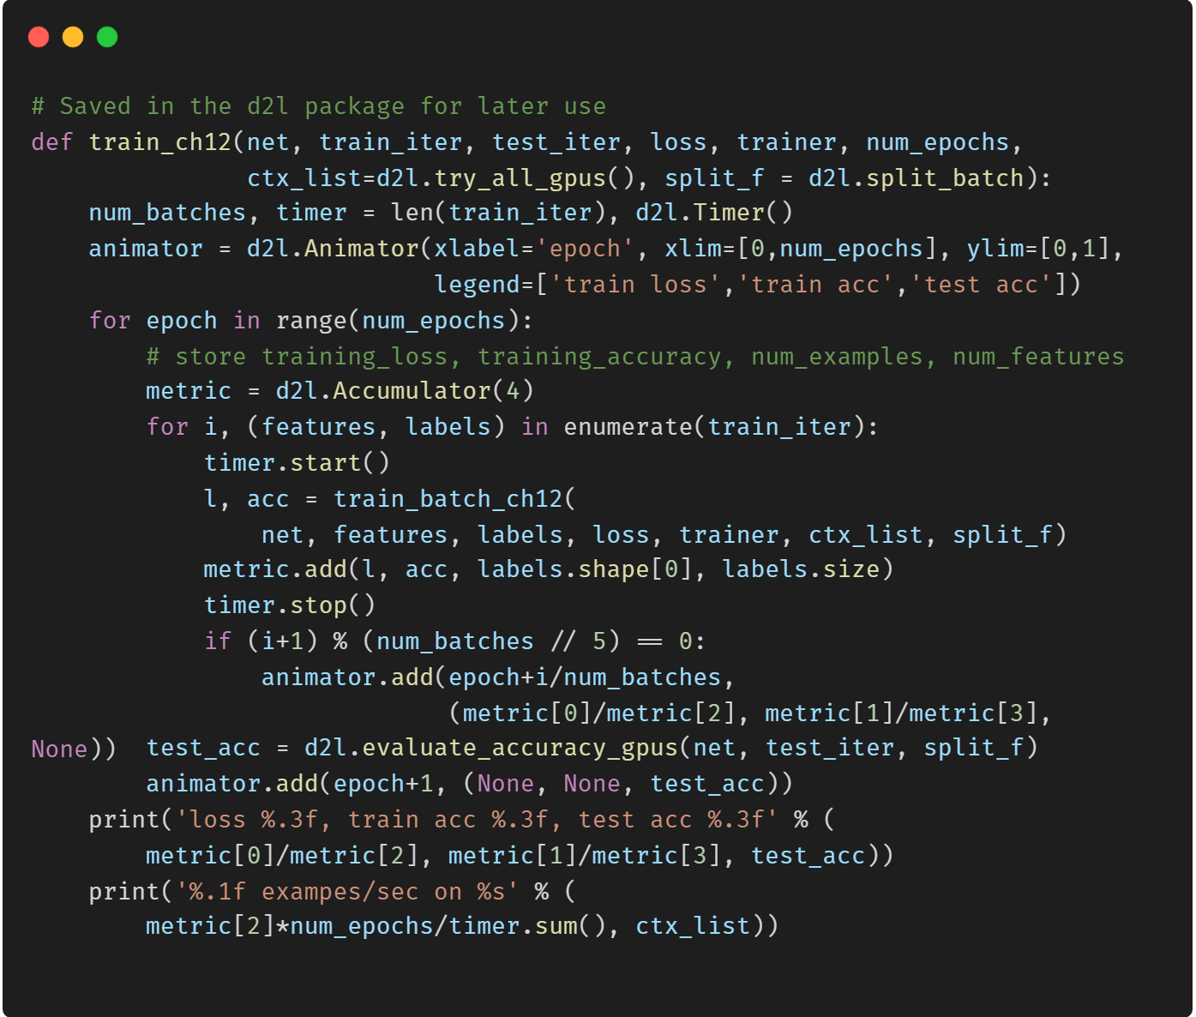
Using a Multi-GPU Training Model

Slide 19
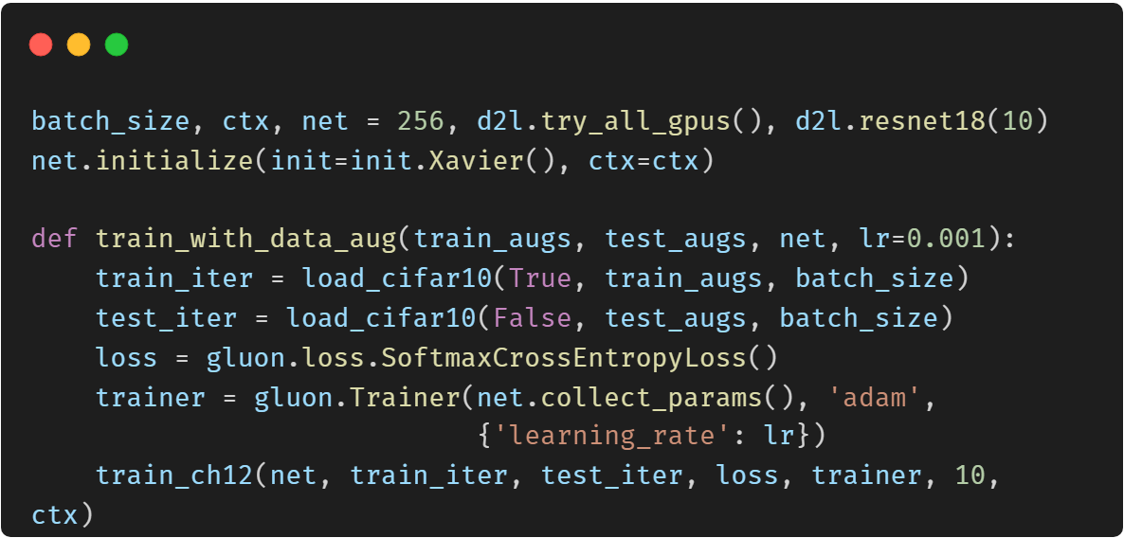
Using a Multi-GPU Training Model

Slide 20
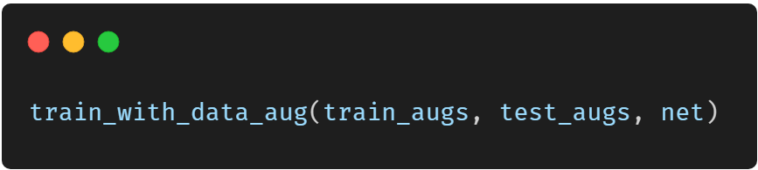
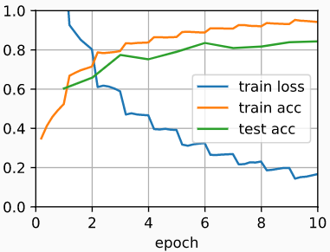
Using a Multi-GPU Training Model

Slide 21
Thank You！
Does anyone have any questions?
Twitter: @walkercet
Blog: https://ceteongvanness.wordpress.com

Slide 22
Resources
Dive into Deep Learning

